Slide 1
Third Day

Slide 2
Bellwork
Consider the quote below.
What does it mean to you?
“Be willing to sacrifice what you want now for what most.”
Write your thoughts on a blank sheet of paper and be prepared to discuss.

Slide 3
Google Drive
A Crash Course

Slide 4
What is Google Drive?
Google Drive is an online resource provided to EVSC students to help with learning and sharing.
Go to drive.google.com to get started!

Slide 5
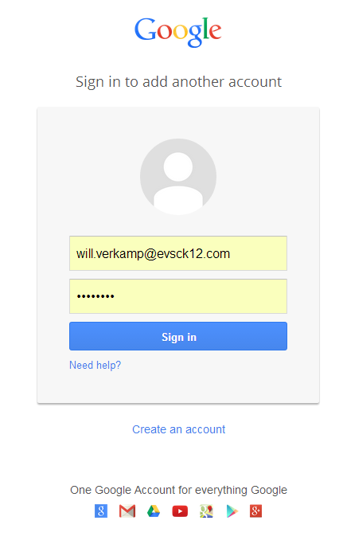
Getting Started
Log in using your EVSC e-mail.
Firstname.lastname@evsck12.com
Password: netbook password
DO NOT USE YOUR PERSONAL GOOGLE ACCOUNT!

Slide 6
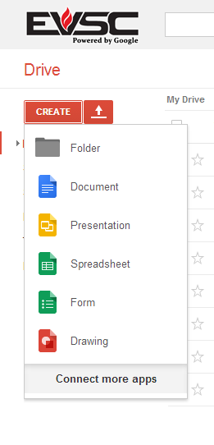
Create a Folder
To create anything in Drive, click the red “Create” button.
Select “Folder.”
That’s this one!

Slide 7
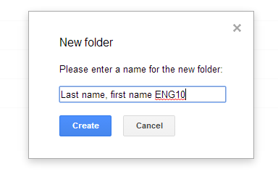
Name the Folder
To name your file, use the format:
Last name, First name ENG10
Click “Create”

Slide 8
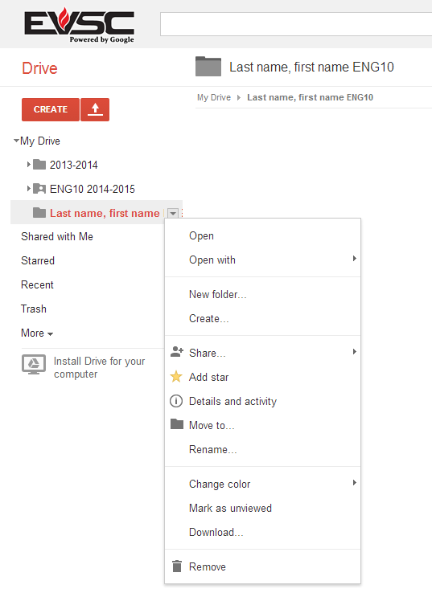
Share the Folder
To Share anything in Drive, either right-click on the file or use the pull-down menu as shown.
Here you go!

Slide 9
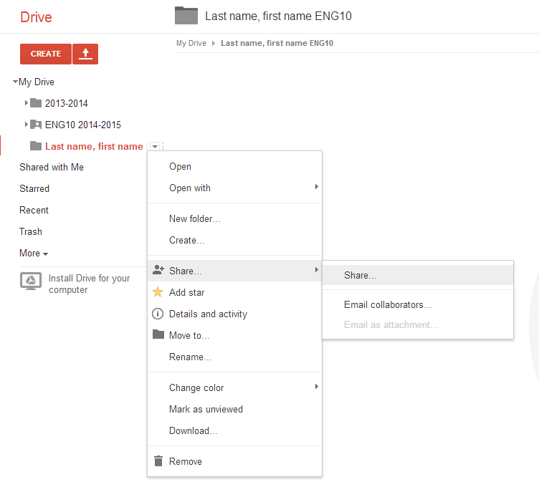

Slide 10
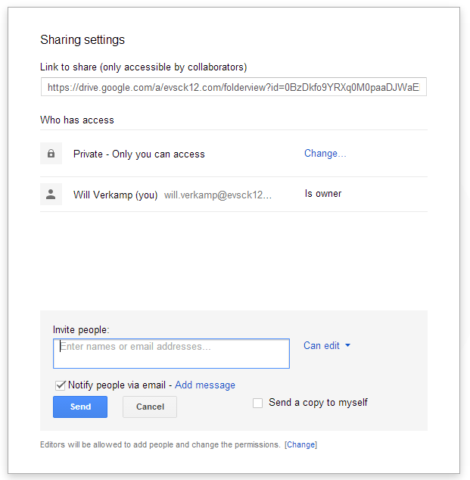
Share the Folder (cont.)
Now, select the “Share” button and start typing in your teacher’s name.
Teacher’s name here!

Slide 11
Try it out!
Test your Drive abilities; create a document in the shared folder you just created.
To see if the document is shared, click on the blue box in the upper right-hand corner of the screen and check the names.

Slide 12
Important
If you create or submit anything to this teacher on Drive, make sure the file is IN THIS FOLDER.
You no longer have to share each individual file.
Drive automatically saves changes, so you don’t have to worry about losing your precious work!

Slide 13
Questions?
If you have any questions, please let me know!

Slide 14
Learning Styles

Slide 15
Learning Styles Survey
Follow the directions to find out what type of learner you are

Slide 16
Visual Learners—65%
Written information, notes, diagrams, and pictures
Unhappy with presentations where they cannot take detailed notes
Should write down as much as possible
Should look at all study materials
Should use charts, maps, videos, notes, and flashcards

Slide 17
Auditory Learners—30%
Rely on the spoken word
Listen to lectures and take notes later or rely on printed notes
Helps to read printed materials aloud
May be sophisticated speakers and specialize in law or politics
Should sit in the front of the classroom where they can hear well

Slide 18
Tactile/Kinesthetic Learners—5%
Work effectively through touch, movement, and space
Learn skills by imitation and practice
Work slowly because info is generally presented more for visual or auditory learners and not them
May benefit from typing notes or acting out different situations

Slide 19
Get Together
Get together in your learning style groups and discuss whether or not you think the descriptions fit you
On a piece of paper, write:
What works well for you in school?
What does not work well for you in school?
Write on board

Slide 20
Setting Goals
Goals should be attainable—not so large that you probably would never achieve them
Goals should not be too easy—you should actually have to work a little bit
Goals should have two parts, short-term and long-term

Slide 21
Short-term Goals
Quick time frame
Easy to measure
See progress right away
Examples:
Have no unexcused absences the first nine weeks
Pass all classes the first nine weeks
Have no referrals the first nine weeks

Slide 22
Short-Term Rewards
Rewards make you feel good about achieving those short-term goals and keep working hard to achieve the long-term goals
Examples:
Ice cream or go out to eat
New clothes
Music
Go to the movies
Have friends over
Money for As on report card

Slide 23
Long-term Goals
Cover a more extended period of time
Are a little more significant
Short-term goals help you get here
Examples:
Have no unexcused absences for the semester
Pass all classes for the semester
Have no referrals for the semester
Graduate from high school on time

Slide 24
Long-Term Rewards
Long-term rewards are why you set your goals in the first place
Examples:
Maintain citizenship for school dances
Respect from peers, teachers, and family
Not have to repeat classes next year
Graduate on time with the rest of the class
Get a job that pays well or get into college to earn a higher degree

Slide 25
Make Yourself Accountable
Tell your goals to other people so they can be honest with you when you aren’t staying on track and help you when you need it
Think of at least one adult in your life who is a positive role model, someone who does the right thing, who you can look up to as a good example, and who can motivate you when you struggle

Slide 26
Set Goals
Set your own goals to help you start off your freshman year the right way

Slide 27
Brainstorm
“Be willing to sacrifice what you want now for what most.”

Slide 28
Mandala
Mandala originates from the Sanskrit word for circle
Contains symbols of a person’s inner self, guiding principles, and overall ideas of the world
Objects can be people, places, and ideas that are central to a person’s life

Slide 29
Your Mandala
Inner circle is you (glue your picture here)
Outer circle should contain things that symbolize you
Family members, close friends
Beliefs
Hobbies and interests
Future goals/plans
Favorites (classes, foods, music, books, etc.)
More important things should be larger while less important things should be smaller

Slide 30
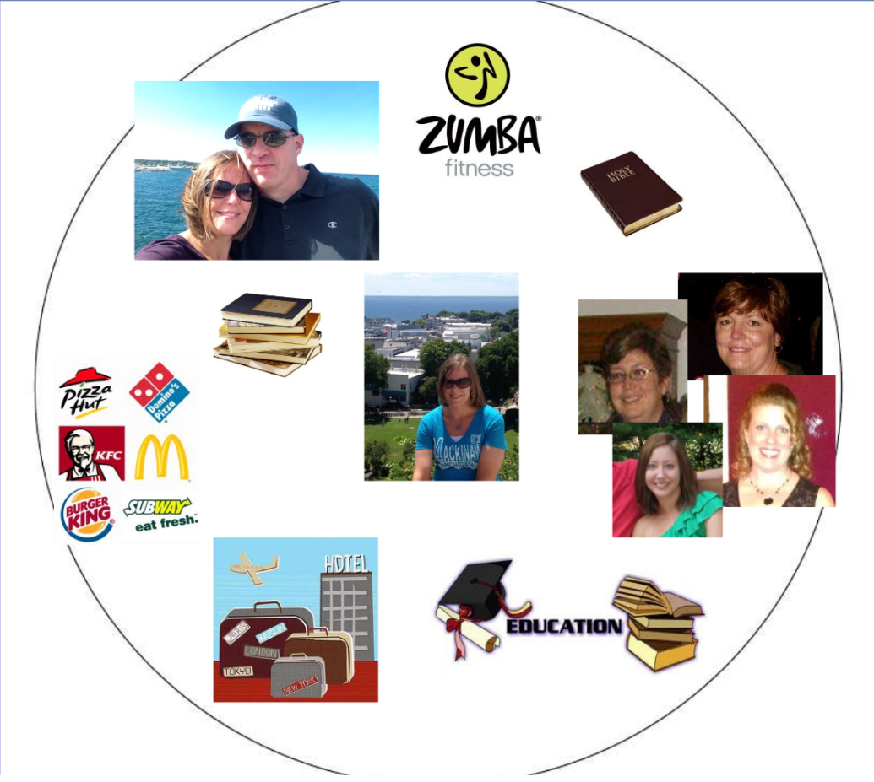
Example Mandala

