Slide 1
Personality Survey
Do we all have the same personalities?
Follow the directions to find out what kind of animal you are!

Slide 2
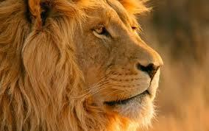
Type A: Lion
Born leader
Likes to accomplish things with immediate results
Time frame is NOW!
Decisive
Wants quick, summarized communication
Often feels threatened by questions
Not afraid of pressure or confrontation

Slide 3
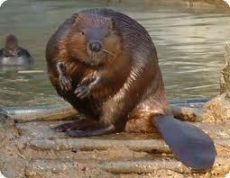
Type B: Beaver
Keeps a close watch on emotions
Actually reads the instruction books
Likes to make careful decisions
Likes using critical thinking skills to solve problems
Lives by the motto, “Let’s do it right!”
Often turns anger inward
Tends to focus on the past

Slide 4
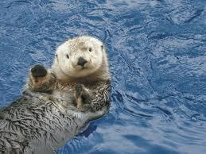
Type C: Otter
Just wants to have fun
Great at motivating others to action
Tends to avoid the fine print
Focuses on the future
Tends to avoid confrontation at all costs
Great networker
Very susceptible to peer pressure

Slide 5
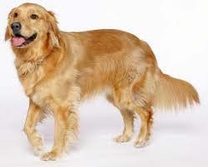
Type D: Golden Retriever
Is loyal
Has a strong need for close relationships
Has a deep need to please others
Has a heart full of compassion
Is the definition of the word “adaptable”
Often reacts to sudden changes
Holds stubbornly to what he/she feels is right

Slide 6
Get Together
Get together in your animal groups and discuss whether or not you think the descriptions fit you
On a piece of paper, write:
What works well for you in school?
What does not work well for you in school?
What other “animal” could you work well with?
What other “animal” do you think you would not work well with?
Write on board

Slide 7
Writing Assignment
On a Google Drive Document, answer the following questions in complete sentences in paragraph form. Write enough to answer the questions.
Why are you in a self-contained class?
What are you good at in English and what do you struggle with?
What do you plan to do for yourself to make sure you are successful this year?
How can I help you succeed?

Slide 8
Homework
Parent Contact Form Signed

